Slide 1
Statistics for Analytics (BAN 100)
Assignment 1
by : Aaron Gonsalves
(161288196)

Slide 2
METADATA DESCRIPTION OR DATA DICTIONARY

Slide 3
Variable Name | Description | Type
Manufacturer | The name of the company brand. (eg: Audi, Cadillac, Ford, etc.) | Character
Model | The model name or version of the car. (eg: Century, Astro, etc.) | Character
Category | The type of car based on its size and shape. (eg: Small, Large, etc.) | Character
Min_Price | Minimum price for a car model | Numerical
Mid_Price | Average of minimum and maximum prices. | Numerical
Max_Price | Maximum price for a car model | Numerical
City_Fuel | Miles per gallon in city | Numerical

Slide 4
Variable Name | Description | Type
Hwy_Fuel | Miles per gallon on highway | Numerical
Air_Bags | Number of air-bags available in the car. | Character (Categorical variable)
Drive_Train | A series of components used to transfer power from engine to wheels. Specifies its type here. | Numerical (Continuous variable)
Cylinders | No. of cylinders in the car. | Numerical (Categorical variable)
Engine_size | The amount of fuel that can be pumped through a car’s cylinders. | Numerical
Max_HP | Gives the maximum horse power of the car. | Numerical
Max_HP_RPM | Revolutions per minute to achieve maximum horse power. | Numerical

Slide 5
Variable Name | Description | Type
RPM_High | RPM required by the car to travel 1 mile in its highest gear | Numerical
Manual | The type of transmission is specified i.e. either manual or automatic | 0/1 Numerical (Categorical variable)
Fuel_Tank | Capacity of the fuel tank of the car | Numerical (Continuous variable)
Passenger | No. of passengers that can fit in the car | Numerical
Length | Length of the car | Numerical
Wheel_Base | Distance between centres of front and rear wheels in inches | Numerical (Discrete variable)
Width | Width of the car | Numerical
U_Turn_Diam | The minimum diameter of free space needed by car to make a u-turn | Numerical

Slide 6
Variable Name | Description | Type
Rear_Room | Legspace available in the rear area of the car | Numerical
Luggage | Luggage space available in the car | Numerical
Weight | Weight of the car | Numerical
Domestic | Showing if the car is made domestically or in foreign | 0/1 Numerical (Categorical variable)

Slide 7
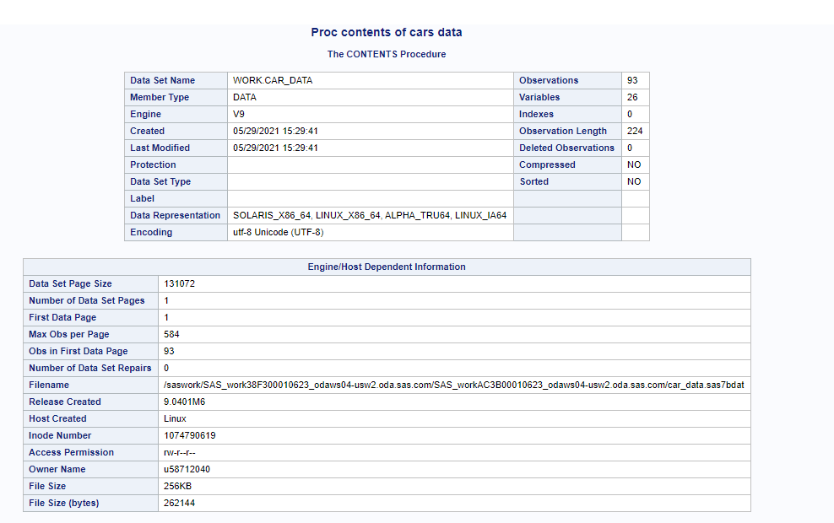
title 'Proc contents of cars data'; proc contents data=work.car_data; run;

Slide 8
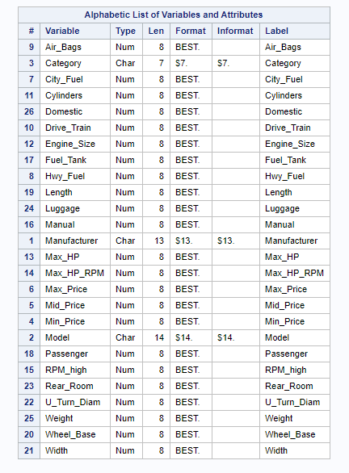
All the variables are present and as expected.
The data types of variables are correctly mentioned.
The labels provided are sensible.

Slide 9
DESCRIPTIVE STATISTICS

Slide 10
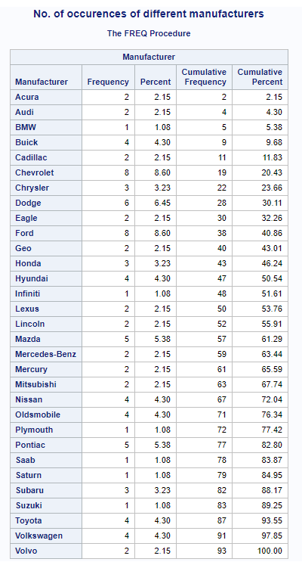
PROC FREQUENCY ON CARS(MANUFACTURER)
title 'No. of occurences of different manufacturers'; proc freq data = work.car_data; table Manufacturer; run;
After analyzing the frequency of different car manufacturers we found:
Ford & Chevrolet are the 2 main manufacturers occurring equally at 8.60%.
The 2nd largest manufacturer is Dodge at 6.45%.
All other manufacturers have a close percentage to each other.
Except BMW, Infiniti, Plymouth, Saab, Saturn and Suzuki who have the least frequencies.

Slide 11
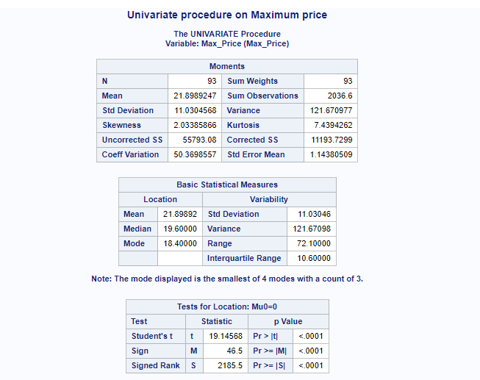
PROC UNIVARIATE ON CARS (Max_Price)
title 'Univariate procedure on Maximum price';
proc univariate data = work.car_data;
var Max_Price;
run;
CENTRAL TENDENCIES
1 ) Mean
Max price is located at 21.89
2) Median – 19.6
3) Mode is the most likely value and here it is 18.4 which means 18.4 is mostly the maximum price for all manufacturers.
Skewness is 2.033, so this is a right skewed distribution.
Kurtosis – 7.439

Slide 12
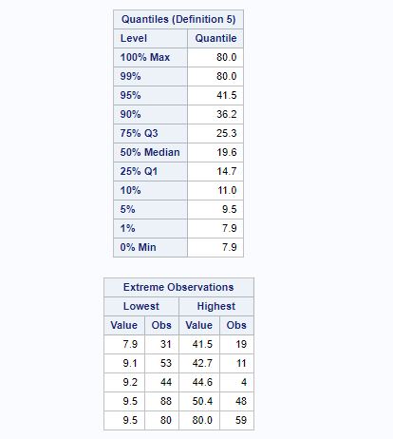
Quantiles help in determining how many values are above and below from a certain threshold.
Max value - 80.0
Min value - 7.9
1st quartile (25th percentile) – 14.7
Third quartile - 25.3
Interquartile range = 25.3-14.7 = 10.6
Overall range = 80.0 – 7.9 = 72.1
The max value and 99% value are equal indicating that there are no outliers.

Slide 13
Descriptive Statistics of Car data (mean, median, skewness, Stddev, Var)
title 'Means procedure on the whole car data';
proc means data = work.car_data mean median Skewness Stddev Var;
run;
The variables : Drive_train, Max_HP_RPM, Manual, Length, U_Turn_Diam, weight and Domestic have negative skewness indicating a left skewed distribution.
The standard deviation is much higher in Max_HP_RPM, RPM_high and weight.
The variance in mid_price and length is quite bigger compared to others.

Slide 14
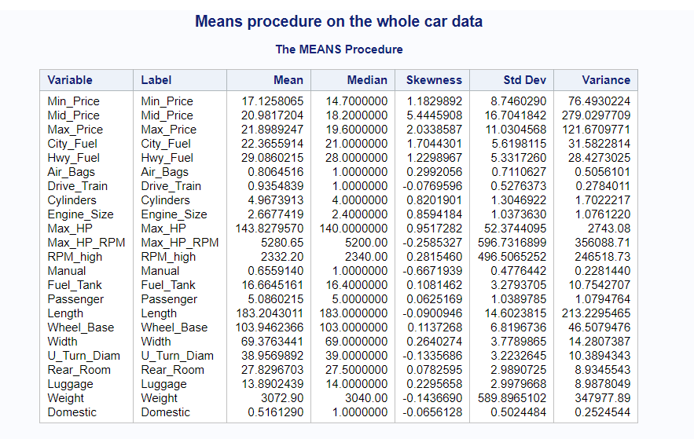

Slide 15
Questions and observations about the data
What are the basis of or what are the measuring units for max_price, mid_price and min_price?
Are City_fuel and Hwy_fuel representing the average of the car? If yes then in what terms is it calculated : miles/gallon or kms/gallon?
What classifications are considered in Air_Bags and Drive_Train?
A clear difference between Max_HP_RPM and RPM-high should be provided.
What is the measuring unit of engine size : litres, metres or cubic metres?
Are manual and domestic variables categorical : yes/no?
Proper measuring units for many variables like City_fuel, Hwy_fuel, length, width, u_turn_diam, wheelbase, rear_room should be provided.

Slide 16
THANK YOU

